Slide 1
Object Oriented Programming
A-Level Computer Science

Slide 2
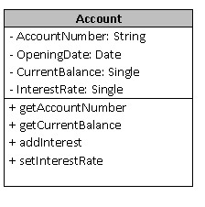
Class Diagram
Use a + or – to indicate visibility of a property or method
+ means method or property is Public
- means methods/property is private
Use a # to indicate it is protected

Slide 3
Constructors
A constructor is a special method which in OOP allows us to have some control as to how objects are initialised.
They are created when a class instantiates an object. Every defined class has a default constructor.
We can define our own constructors
The keyword NEW tells VB to allocate memory for the class – this is telling VB to construct the class (Object)

Slide 4
Designing a Class
We shall build a class for a bank account
What operations will be needed?

Slide 5
Designing a Class
We shall build a class for a bank account
What operations will be needed?
Pay money into the account
Draw money out of the account
Find the balance
Print out a statement
Change the address of the account holder
Print out the address of the account holder
Change the state of the account
Find the state of the account
Change the overdraft limit
Find the overdraft limit

Slide 6
Encapsulation
We shall define a bank account (Class Account) which encapsulates a balance variable along with code to perform the following operations:
Pay money into the account
Draw money out of the account
It returns true if it can withdraw or false if insufficient funds.
Find the balance
Create the class
Create two constructor methods (1 for an opening balance given and 1 for not stating an opening balance)

Slide 7
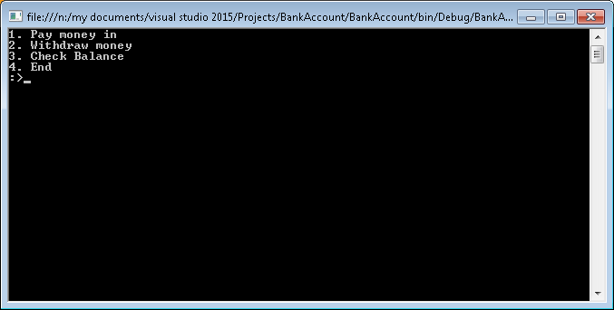
In Sub Main
Create a new TestAccount with £10 funds to start with.
Set up a menu:

Slide 8
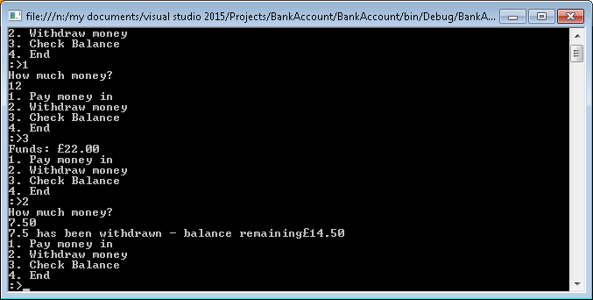

Slide 9
Adding to the Bank Account
Add an interest rate of 1%
Create routines to check the Interest rate and add routines to sub_Main to test this
Add an AccountID that can be viewed but not changed
Alter constructor classes and add a need to set the account ID when constructing an account

Slide 10
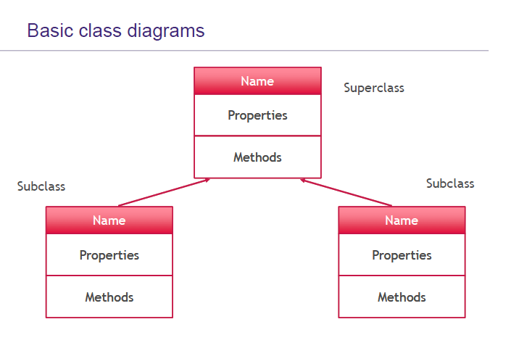

Slide 11
Inheritance
Where one class can share the methods and properties of its parent class. This promotes efficiency because code from the parent class can be reused by the child class.
A set of characteristics (properties and methods) are defined in the SuperClass and shared down the hierarchy structure
A class can have several subclasses

Slide 12
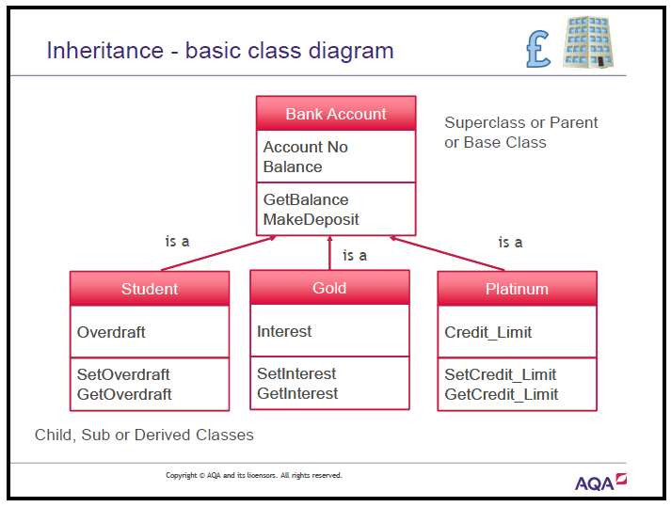

Slide 13
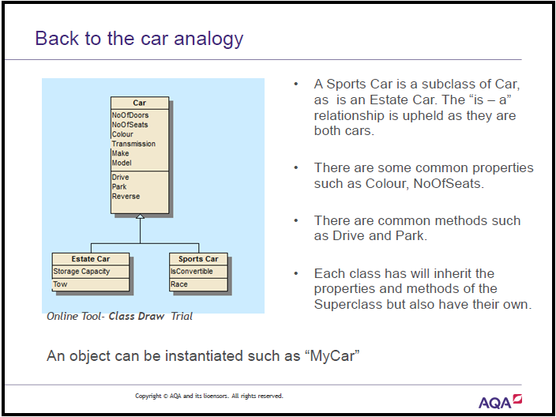

Slide 14
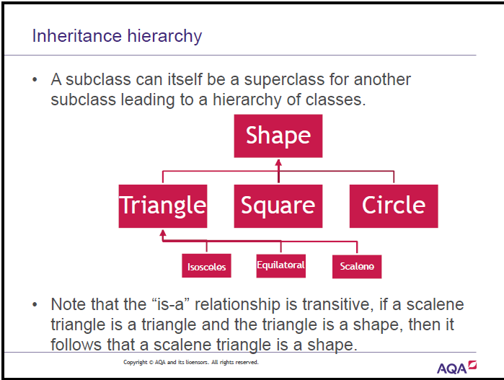

Slide 15
Example Exam Question
How the exam paper has dealt with Inheritance in the past
June 2014

Slide 16
Polymorphism
Many Forms
A method in the super class which is inherited, redefined with the same name and performs a different task.
Change the function of how a method works depending upon the class.

